Slide 1
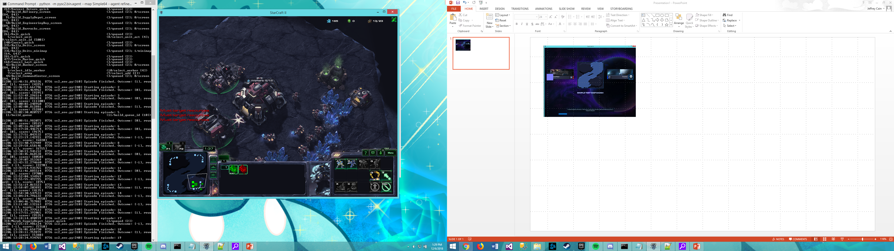
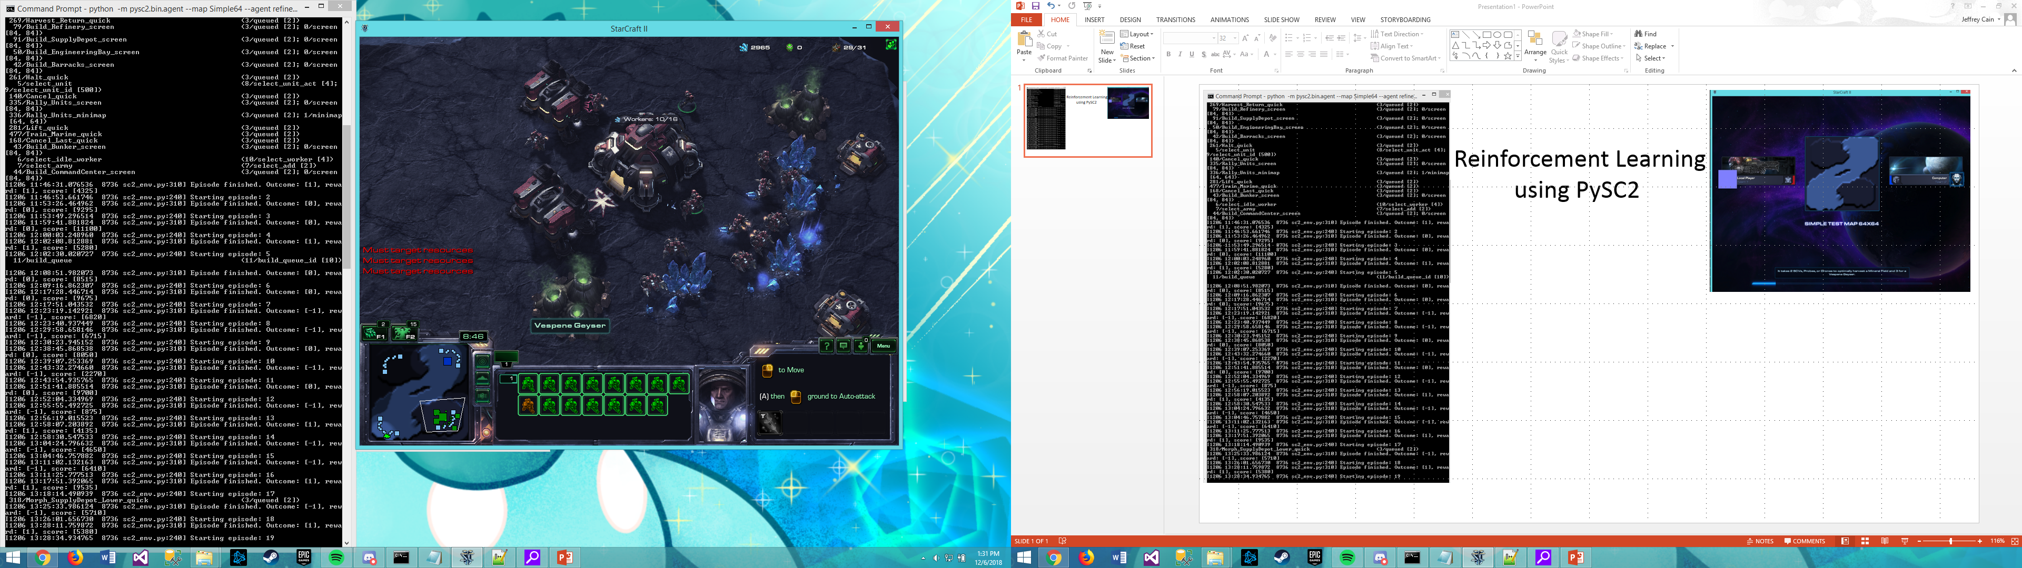
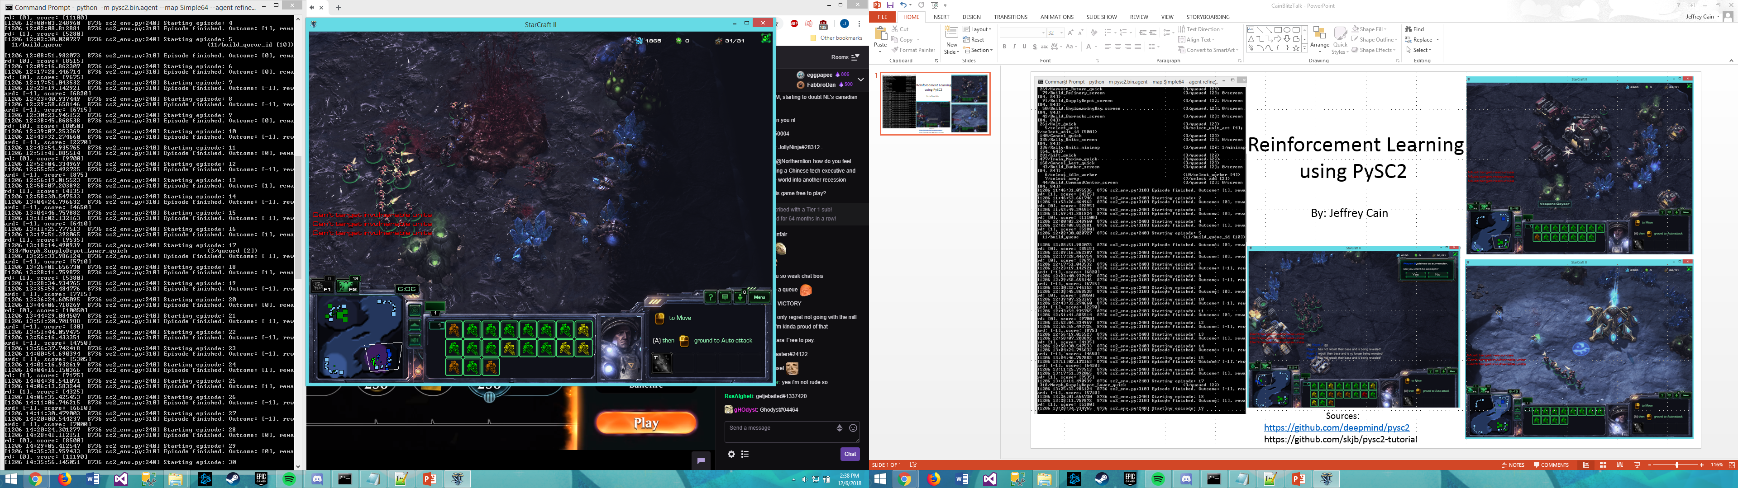
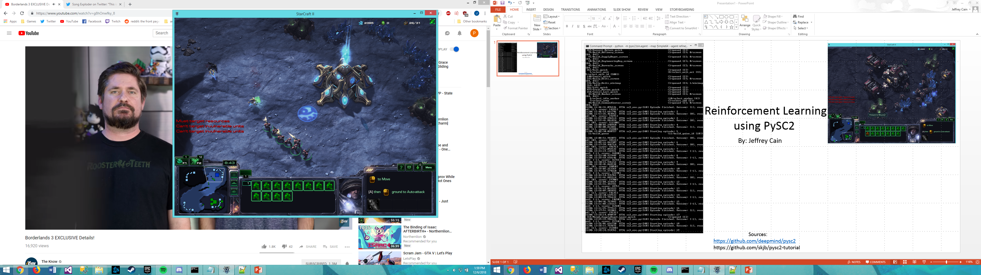
Reinforcement Learning
using PySC2
By: Jeffrey Cain
Sources:
https://github.com/deepmind/pysc2
https://github.com/skjb/pysc2-tutorial

